Slide 1


Chapter 9
Managing Storage for a Virtual Machine
Virtualization Essentials

Slide 2
Chapter 9 Objectives
Understand how virtual machines connect to storage resources
Examine the configuration options for disk storage connecting to virtual machines
Examine tuning practices from storage devices connected to virtual machines
2

Slide 3
Connecting Virtual Disks
The amount of data being managed is rapidly growing
Storage connects to virtual machines similarly to physical servers but is abstracted from the VMs
Many storage best practices used in the physical environment apply very well in the virtual world
Thin provisioning
Data deduplication
Adequate storage I/O is key for good performance
Storage connects through specialized storage or standard network interfaces
3

Slide 4
Virtual Storage
Model shown is VMware architecture
Hypervisor provides storage and network interface emulators that the virtual machine drivers connect to
Hypervisor then manages connections and traffic to the physical interfaces
4

Slide 5
Virtual Storage (II)
Model is Xen based though Microsoft is similar
Virtual machines pass data blocks through unique privileged guest that handles I/O rather than hypervisor layer
5

Slide 6
Data Deduplication
Duplicated entities are replaced by pointers to the original
Works at byte, block, and file levels
Can reclaim between 30 to 90 percent of storage space
6

Slide 7
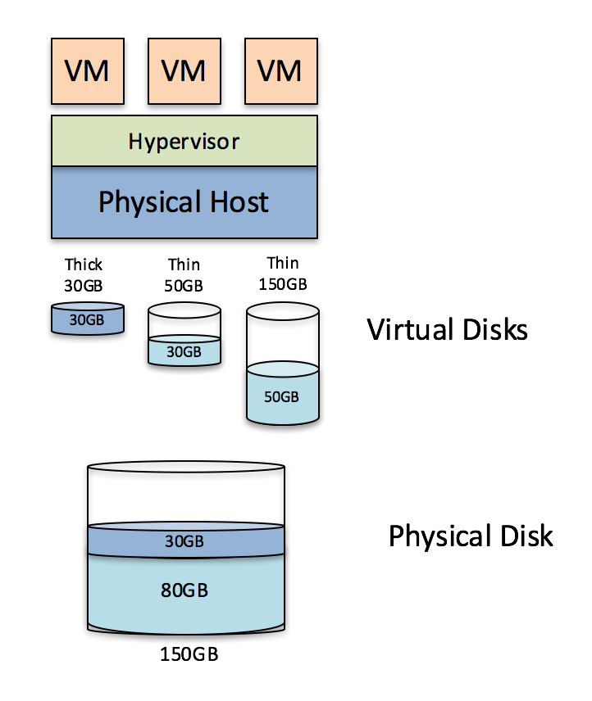
Thin Provisioning
Does not pre-allocate disk space when the file system is created like thick provisioning
Could lead to issues if file systems actually fill the allocated space
Similar to memory overcommit but for storage
7

Slide 8
Storage I/O Control
Allows Quality of Service (QOS) policy assigned to a single VM or a group of VMs
Guarantees appropriate storage throughput in the event of I/O contention to protect business-critical applications
8

Slide 9
Other Topics
Tiered Storage
Storage arrays that have different classes of storage offering multiple levels of service
Files can be dynamically migrated based on need
Solid-State Disk Drives (SSD)
Use solid-state memory instead of spinning platters and moving parts
Fifty times faster than current disks
Storage Virtualization
One model pools internal server storage from multiple servers into a virtual SAN, which is more cost effective than a separate NAS or SAN
9

Slide 10
Chapter 9 Summary
Data storage volume is rapidly increasing in both the physical and virtual environments
Virtual machines connect to storage devices as physical servers do
Adequate storage I/O bandwidth is key for good disk performance with VMs
Physical best practices translate well to the virtual environment
There are numerous advanced features that make more efficient use of disk storage or provide better storage I/O
10

